Slide 1
Vestibular & balance rehab
for the concussed Individual
Carrie Tingley Hospital

Slide 2
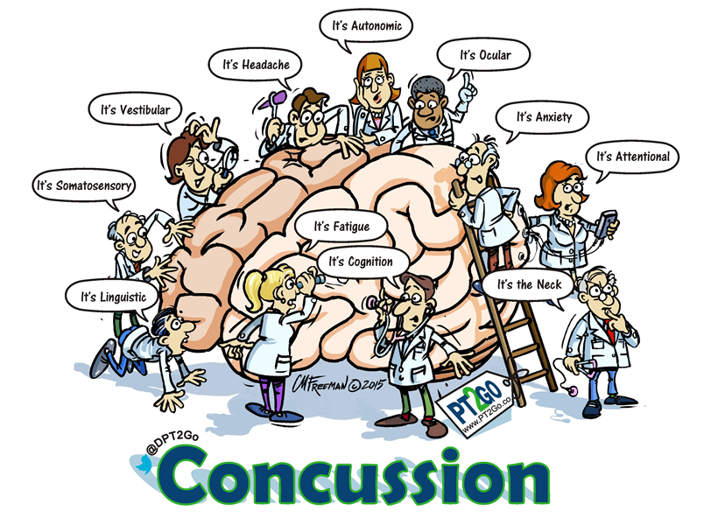

Slide 3
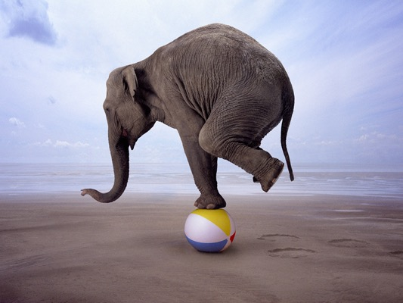
the Vestibular System
Sensing and Perceiving Motion
  3 semicircular canals
  2 otoliths (utricle/saccule)
Gaze Stabilization
  Vestibular Ocular Reflex (VOR)
Postural Control
  Vestibular Spinal Reflex (VSR)

Slide 4
Post Concussion Vestibular Exam Components
Cervical Range of Motion
Cervical Ligamentous Integrity
General Extremity strength screening
Fine Motor/Coordination Assessment (finger to nose, finger to object etc)
Cranial N. Exam
Ocular Motor Range of Motion
Smooth Pursuit
Saccades
Vestibular Ocular Reflex (horizontal and vertical at different speeds)
Head Thrust Test VOR Cancellation Convergence
Spontaneous Nystagmus
Fixed Gaze Nystagmus
Head Shaking Nystagmus
Dix Hall-pike and Roll Test (rule out BPPV)
Vertebral Artery Test
Tragal Pressure/Valsalva for fistula/inner ear tear
Dynamic Visual Acuity (eye chart) Romberg,
Sharpened Romberg,
Standing Foam (modified CTSIB)
Dynamic Gait Index or Functional Gait Assessment
Tandem walking
Single Leg Stance
BESS Test if applicable / HiMAT
Motion Sensitivity Quotient (if complaints of motion evoked dizziness)
Modified Balke Protocol/ Buffalo Treadmill Test (determine threshold for aerobic activities)

Slide 5
Vestibular evaluation
VOMS +
Smooth Pursuits (CNS) Vertical/ Horizontal *
Saccades (CNS) Vertical/ Horizontal *
Eye Head to Periphery (VOR)
Gaze Stabilization (VOR) Vertical/ Horizontal *
Head Thrust (VOR)
Head Shaking Nystagmus (VOR)
Dynamic Acuity (VOR)
Visual Motion Sensitivity *
Convergence *
90% accurate in identifying
patients with concussion

Slide 6
Vestibular evaluation
VOMS
SMOOTH PURSUITS (CNS) HORIZONTAL/ VERTICAL
Head Still - Follow target; various speeds up & down
SACCADES (CNS) Vertical/ Horizontal
Head Still - Eyes move quickly between targets
w/pursuit/saccade problems
Patients are often high symptomatic
Unable to read or watch TV without headaches
Video games, computers, phone scrolling
Diving is difficult

Slide 7
Vestibular evaluation
VOMS
Eye to Head Periphery (VOR)
Turn you head and focus on a target at each side, move head at a moderate speed 5 times
Normal up to 2 beats of nystagmus, readjustment, lags, visual, redirection, or nystagmus

Slide 8
Vestibular evaluation
VOMS
Gaze Stabilization (VOR) Horizontal/ Vertical
  Keep your eyes on a stationary object held midline, eye level approx. 12” away, turn your head side to side 5 times
  180 bpm; 20 degrees each side

Slide 9
Vestibular evaluation
VOMS
HEAD THRUST (VOR)
Tester passively moves the head in a horizontal pattern 10-15 degrees off center moving with slow movements & gradually increasing speed, with no set pattern, as the patient is instructed to maintain gaze on examiner’s nose. (30 degree head tilt)
Abnormal if patient has to make corrective saccades.

Slide 10
Vestibular evaluation
VOMS
Head shaking Nystagmus (VOR)
Close eyes as the tester moves your head side to side for 20 counts, and actively move with the tester (keep head tilted 30 degrees forward flexion)
Abnormal if nystagmus is present when patient immediately opens eyes (typically nystagmus beats to the weaker side)

Slide 11
Vestibular evaluation
VOMS
Dynamic Acuity (VOR)
Read the lowest line on a Visual Wall Chart while keeping head still. Then read the same line again while the tester passively rotates the head side to side, then up and down. 2Hz per minute 15 degrees in each direction
Abnormal if fixation is not maintained. Normally a patient can maintain their focus or the acuity changes one line during head movements. People with vestibular dysfunction often can only read three lines above static acuity during head movements

Slide 12
Vestibular evaluation
VOMS
Visual Motion Sensitivity
  Stand with feet shoulder width apart facing busy clinic
  Patient hold arm outstretched and focuses on thumb
  Rotate as a unit, head, eyes and trunk at an amplitude of 80 degrees
  Use metronome to ensure speed of rotation is maintained at 50 beats per minute

Slide 13
Vestibular evaluation
VOMS
Convergence
Convergence insufficiency (this test is performed with both eyes open):
Patient will focus on an object.
Practitioner will slowly move the object closer to the patient’s eyes.
Patient will indicate to practitioner when a single object becomes 2 (eg, “double vision”)
Patient will hold the object at the point of vision change and the practitioner will measure distance.
Positive test:
> 6 cm indicates convergence insufficiency (this often resolves
Possible restrictions: limited or no geometry, no math, no computers, no texting.
Consider neuro-ophthalmology or neuro-optometry referral if symptoms do not resolve within 3 to 4 weeks or are persistently 20 cm.

Slide 14
Case Study
History: 15 y/o female who was referred due to two concussions that occurred in 2016/ 2017.
First: In December 2016, She landed on her head while tumbling in gymnastics . Sx: occipital headaches, dizziness, photophobic . School was missed for a few days, returned to sport 2 weeks later. Headaches and symptoms never resolved.
Second: Jan 17th, 2017 fell into a man hole where she hit the back of her head pretty hard. Sx: occipital headaches, neck pain and back pain
Third: Two days later hurt her back while again landing wrong in gymnastics. Sx: Same complaints

Slide 15
Case Study - Evaluation
Other information: High strung female who is racing for valedictorian at her school. Poor diet, urinates 3x a day, low grade headache 24 hours a day since January. (6 months later) Symptoms magnified when studying for finals.
PT: Evaluation: July 18th, 2017

Slide 16
Case Study - Evaluation
Musculoskeletal exam:
  Limited Cervical ROM 15%
  Trigger points that were palpable along her cervical region (C1-C3) and bilateral upper traps right worse than left.
  Decreased Right shoulder ROM flexion and Abd
Gait/Mobility:
  Able to complete tandem stance without problems. SLS on the right 15 seconds, on the left increased struggles and loss of balance within several seconds.

Slide 17
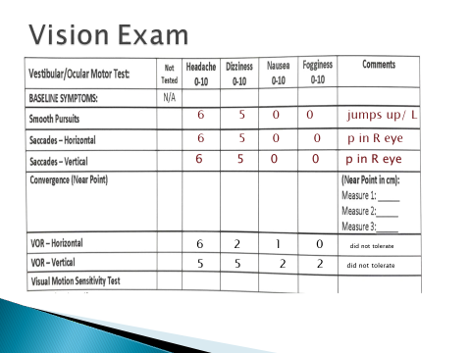

Slide 18
CASE STUDY – Evaluation
More specific tests:
Modified CTSIB: Left deviation in all of the tests indicated weakness of her left vestibular system. Her balance was improved when her eyes were closed indicating that her visual input is contributing to her poor balance.
Dix-Hallpike: no increase in subjective symptoms. Nystagmus observed with completion to the left.

Slide 19
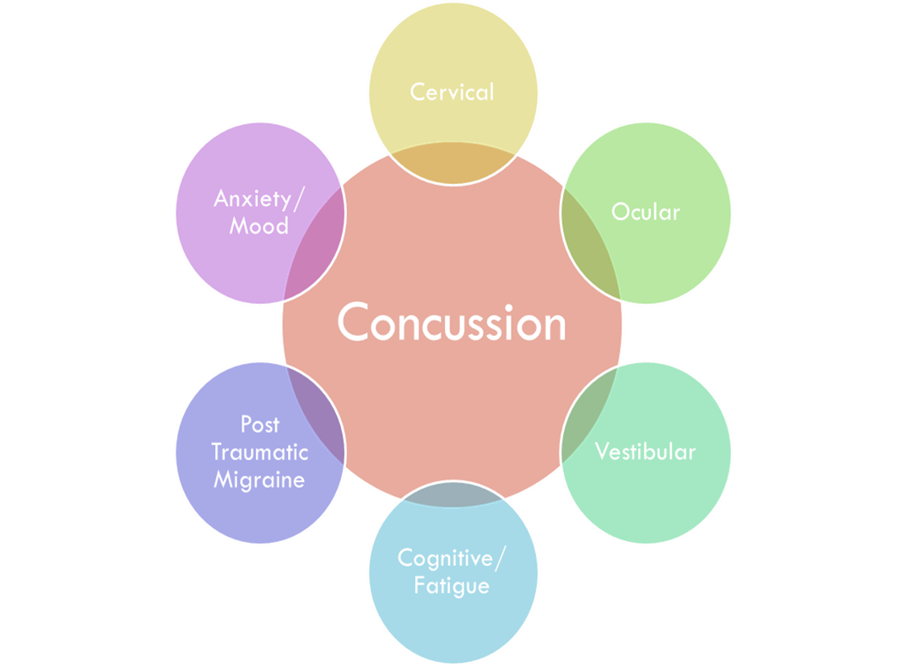
Case Study:
What subtype would you put her in?
What treatment would you recommend?

Slide 20
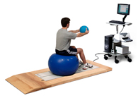
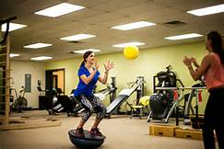
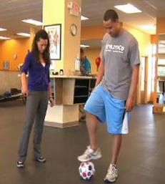
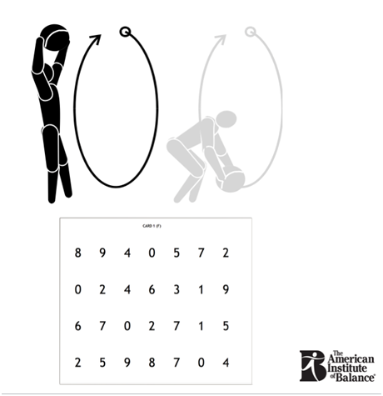
Be Creative
BAL-A-VIS-X

Slide 21
Basic Treatment sequence
Eye Movements- (saccades, optokinetic, vergenge)
Eye head movements; gaze, in phase, out phase (vary speed, range, light)
Visual Targets
Trunk stability
Gravitational movements
Static and Dynamic Balance (Surface Change)
Dynamic Gait Tasks (Vary Environment)
Repositioning

Slide 22
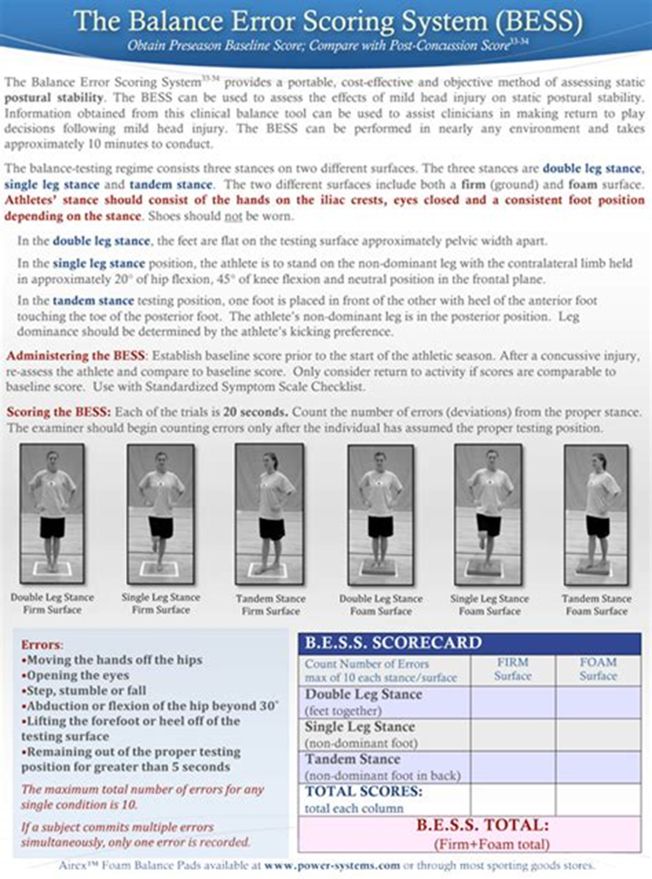
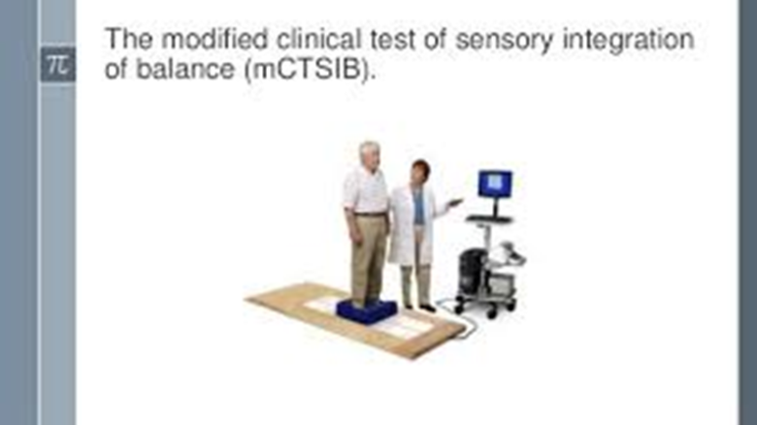
Balance
“BESS demonstrates excellent reliability in pediatric population without evidence of a learning effect”

Slide 23
Saccades
refer to the eye’s ability to quickly and accurately shift from one target to another. This is a critical skill in reading, involving very specific eye movements.
http://eyecanlearn.com/tracking/saccades/

Slide 24
Saccades

Slide 25
Smooth Pursuits
Pursuits is the skill that allows our eyes to smoothly follow moving targets. This is an especially important skills in most sports, allowing us to catch, hit, or kick a moving ball
http://eyecanlearn.com

Slide 26
Eye to Head Peripheral
3 5 5 6 9 2 0
4 7 0 2 4 5 3 9
4 9 0 2 1 3 5 3
8 3 2 4 2 0 3 5

Slide 27
Brain WORK
Visual Discrimination
http://eyecanlearn.com/perception/discrimination/

Slide 29
VOR- Gaze Stabilization
180 bpm

Slide 30
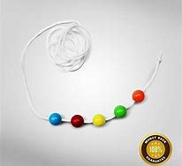
Convergence
Pencil Push ups

Slide 31
THANK YOU

